Slide 1
STAT3007: Introduction to Stochastic Processes
Introduction and Some Basics
Dr. John Wright

Slide 2
Introduction and Some Basics
The word “stochastic” comes from the Greek word for “to guess”
Stochastic means random or chance
A stochastic model is in contrast to a deterministic model
For a deterministic model, if the “experiment” is repeated using the same model with the same initial conditions, you will have the same result every time
This is not necessarily true for stochastic models. Randomness will affect the results.

Slide 3
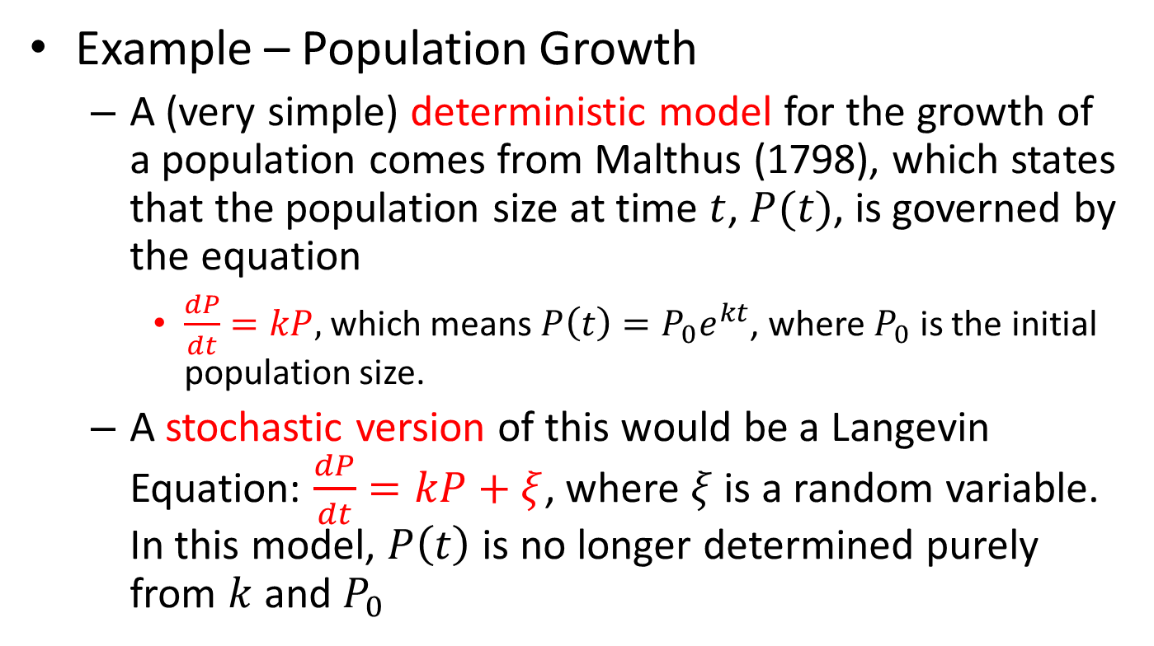
Introduction and Some Basics
Example – Population Growth
A (very simple) deterministic model for the growth of a population comes from Malthus (1798), which states that the population size at time $t$, $P(t)$, is governed by the equation
$\frac{dP}{dt}=kP,$ which means $P\left(t\right)=P_{0}e^{kt}$, where $P_{0}$ is the initial population size.
A stochastic version of this would be a Langevin Equation: $\frac{dP}{dt}=kP+ξ$, where $ξ$ is a random variable. In this model, $P\left(t\right)$ is no longer determined purely from $k$ and $P_{0}$

Slide 4
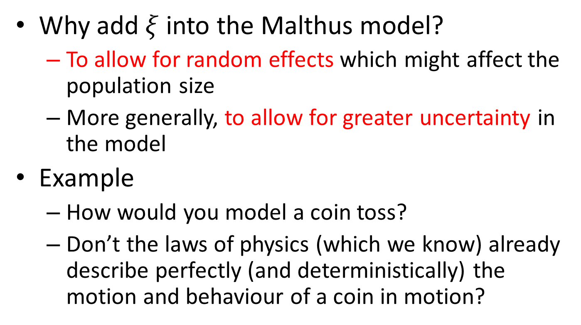
Introduction and Some Basics
Why add $ξ$ into the Malthus model?
To allow for random effects which might affect the population size
More generally, to allow for greater uncertainty in the model
Example
How would you model a coin toss?
Don’t the laws of physics (which we know) already describe perfectly (and deterministically) the motion and behaviour of a coin in motion?

Slide 5
Introduction and Some Basics
So we often want randomness in our models
And if we want to describe and investigate these models with precision, we need mathematics that can handle randomness
This area of mathematics is Probability
The study of Probability began in 16th century Europe
Focused more or less entirely on gambling (see Question 1 of Exercises for Week 1)

Slide 6
Introduction and Some Basics
As time went on, various mathematical greats like Bernoulli, Euler, Gauss, Laplace worked on probability problems
But really it wasn’t until the early 20th century that probability theory was formalized and given a rigorous basis, by Kolmogorov (we’ll hear more from him later in the course)
We won’t concern ourselves with the underlying, ‘deep’ mathematics of probability (for that, read about measure theory)
But let’s remind ourselves of some probability fundamentals we will use again and again

Slide 7
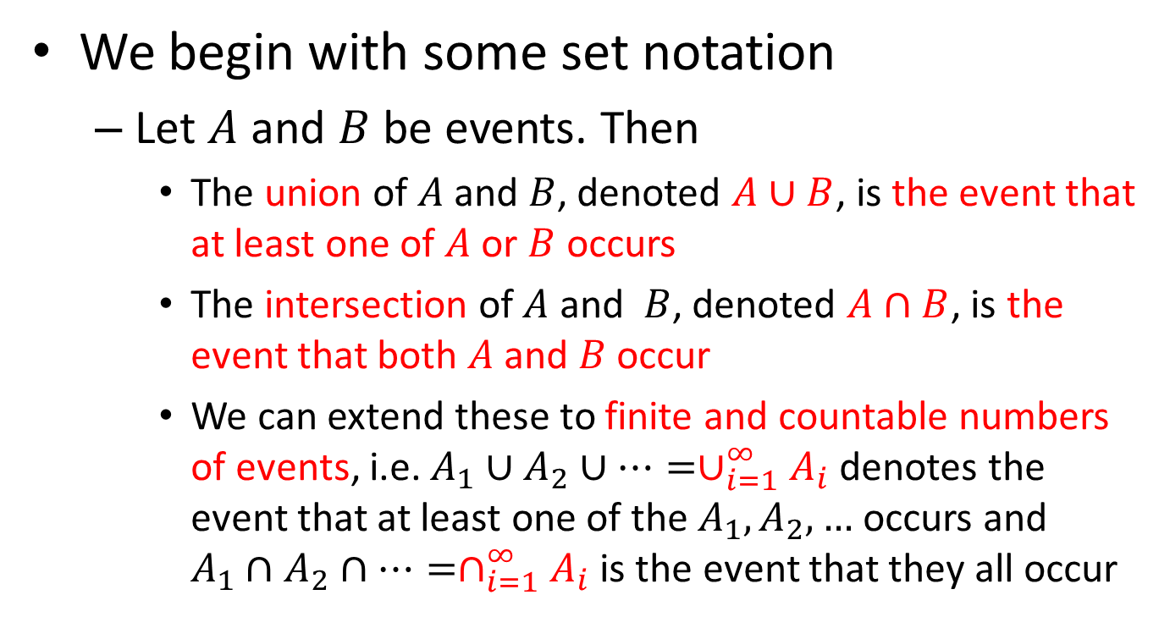
Introduction and Some Basics
We begin with some set notation
Let $A$ and $B$ be events. Then
The union of $A$ and $B$, denoted $A∪B$, is the event that at least one of $A$ or $B$ occurs
The intersection of $A$ and $B$, denoted $A∩B$, is the event that both $A$ and $B$ occur
We can extend these to finite and countable numbers of events, i.e. $A_{1}∪A_{2}∪⋯=∪_{i=1}^{∞}A_{i}$ denotes the event that at least one of the $A_{1}, A_{2},…$ occurs and $A_{1}∩A_{2}∩⋯=∩_{i=1}^{∞}A_{i}$ is the event that they all occur

Slide 8
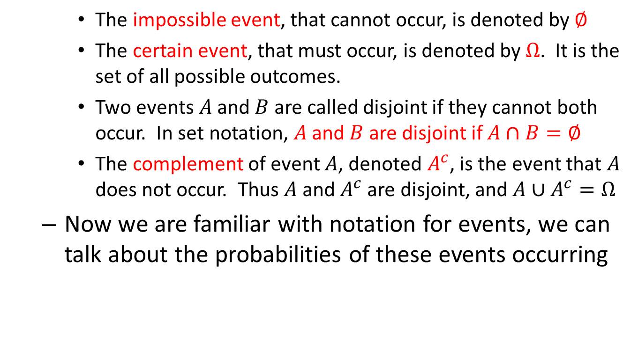
Introduction and Some Basics
The impossible event, that cannot occur, is denoted by $∅$
The certain event, that must occur, is denoted by $Ω$. It is the set of all possible outcomes.
Two events $A$ and $B$ are called disjoint if they cannot both occur. In set notation, $A$ and $B$ are disjoint if $A∩B=∅$
The complement of event $A$, denoted $A^{c}$, is the event that $A$ does not occur. Thus $A$ and $A^{c}$ are disjoint, and $A∪A^{c}=Ω$
Now we are familiar with notation for events, we can talk about the probabilities of these events occurring

Slide 9
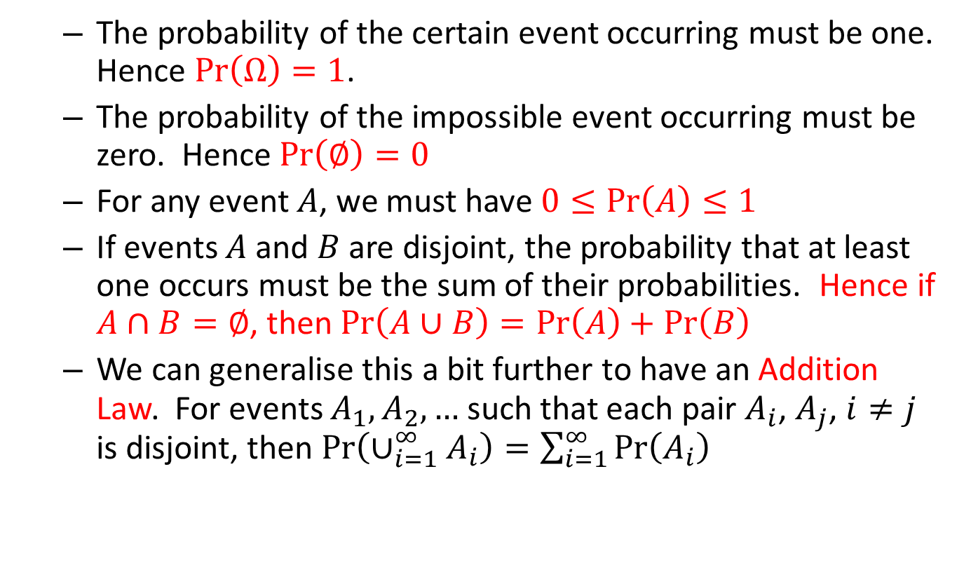
Introduction and Some Basics
The probability of the certain event occurring must be one. Hence $\operatorname{Pr}\left(Ω\right)=1$.
The probability of the impossible event occurring must be zero. Hence $\operatorname{Pr}\left(∅\right)=0$
For any event $A$, we must have $0≤\operatorname{Pr}\left(A\right)≤1$
If events $A$ and $B$ are disjoint, the probability that at least one occurs must be the sum of their probabilities. Hence if $A∩B=∅$, then $\operatorname{Pr}\left(A∪B\right)=\operatorname{Pr}\left(A\right)+\operatorname{Pr}\left(B\right)$
We can generalise this a bit further to have an Addition Law. For events $A_{1}, A_{2}, …$ such that each pair $A_{i}$, $A_{j}$, $i≠j$ is disjoint, then $\operatorname{Pr}\left(∪_{i=1}^{∞}A_{i}\right)=\sum_{i=1}^{∞}{\operatorname{Pr}\left(A_{i}\right)}$

Slide 10
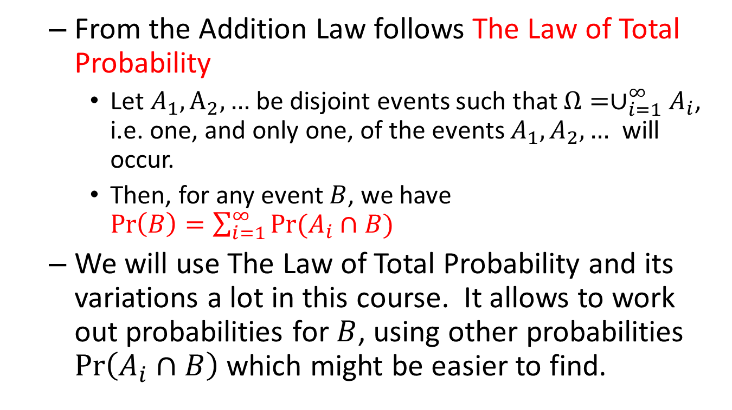
Introduction and Some Basics
From the Addition Law follows The Law of Total Probability
Let $A_{1},A_{2},…$ be disjoint events such that $Ω=∪_{i=1}^{∞}A_{i}$, i.e. one, and only one, of the events $A_{1},A_{2},…$ will occur.
Then, for any event $B$, we have $\operatorname{Pr}\left(B\right)=\sum_{i=1}^{∞}{\operatorname{Pr}{(A_{i}∩B)}}$
We will use The Law of Total Probability and its variations a lot in this course. It allows to work out probabilities for $B$, using other probabilities $\operatorname{Pr}\left(A_{i}∩B\right)$ which might be easier to find.

Slide 11

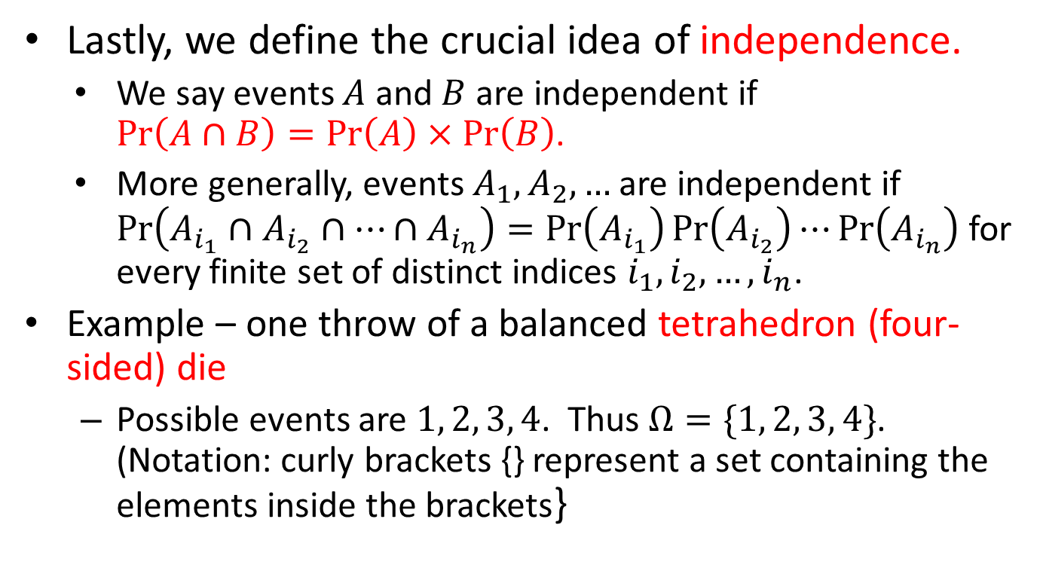
Introduction and Some Basics
Lastly, we define the crucial idea of independence.
We say events $A$ and $B$ are independent if $\operatorname{Pr}\left(A∩B\right)=\operatorname{Pr}\left(A\right)×\operatorname{Pr}\left(B\right)$.
More generally, events $A_{1},A_{2},…$ are independent if $\operatorname{Pr}\left(A_{i_{1}}∩A_{i_{2}}∩⋯∩A_{i_{n}}\right)=\operatorname{Pr}\left(A_{i_{1}}\right)\operatorname{Pr}\left(A_{i_{2}}\right)⋯\operatorname{Pr}\left(A_{i_{n}}\right)$ for every finite set of distinct indices $i_{1},i_{2},…,i_{n}$.
Example – one throw of a balanced tetrahedron (four-sided) die
Possible events are $1, 2, 3, 4$. Thus $Ω=\{1, 2, 3, 4\}$. (Notation: curly brackets {} represent a set containing the elements inside the brackets}

Slide 12
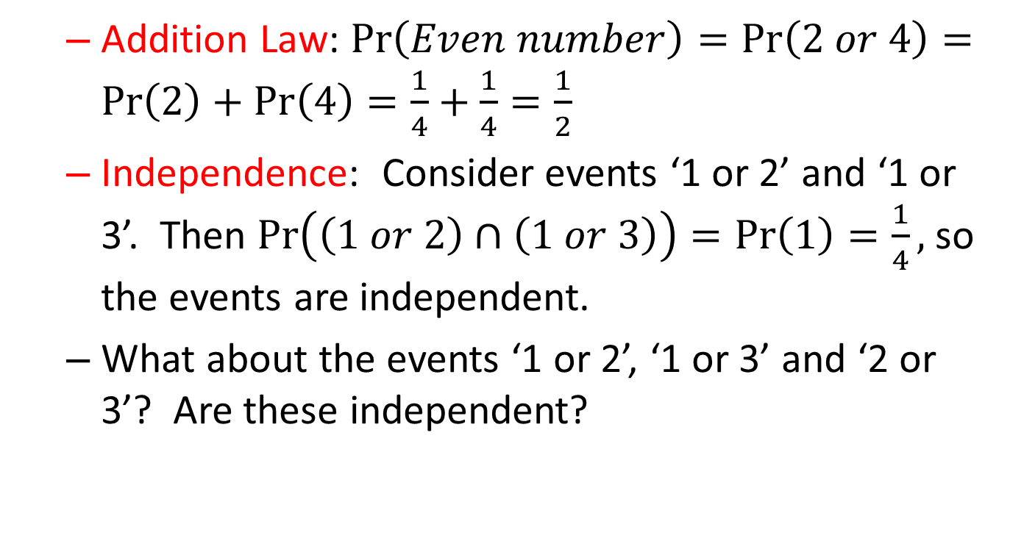
Introduction and Some Basics
Addition Law: $\operatorname{Pr}\left(Even number\right)=\operatorname{Pr}\left(2 or 4\right)=\operatorname{Pr}\left(2\right)+\operatorname{Pr}\left(4\right)=\frac{1}{4}+\frac{1}{4}=\frac{1}{2}$
Independence: Consider events ‘1 or 2’ and ‘1 or 3’. Then $\operatorname{Pr}\left(\left(1 or 2\right)∩\left(1 or 3\right)\right)=\operatorname{Pr}\left(1\right)=\frac{1}{4},$ so the events are independent.
What about the events ‘1 or 2’, ‘1 or 3’ and ‘2 or 3’? Are these independent?

Slide 13
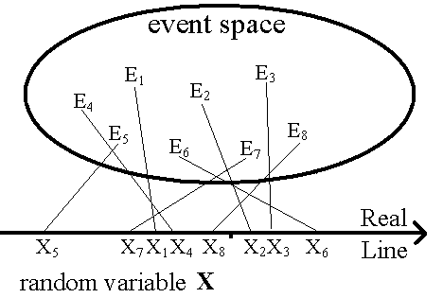
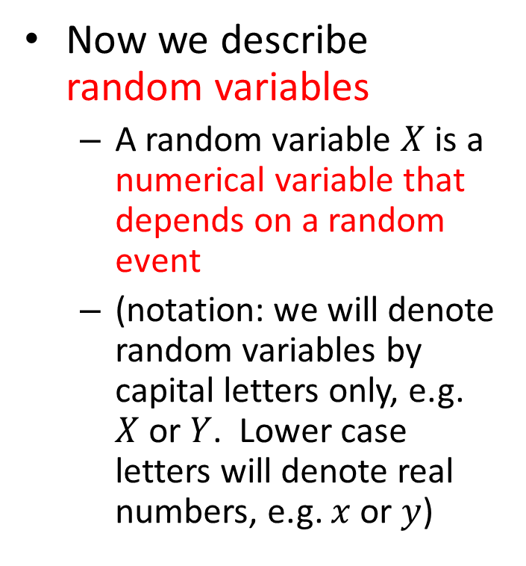
Introduction and Some Basics
Now we describe random variables
A random variable $X$ is a numerical variable that depends on a random event
(notation: we will denote random variables by capital letters only, e.g. $X$ or $Y$. Lower case letters will denote real numbers, e.g. $x$ or $y$)

Slide 14
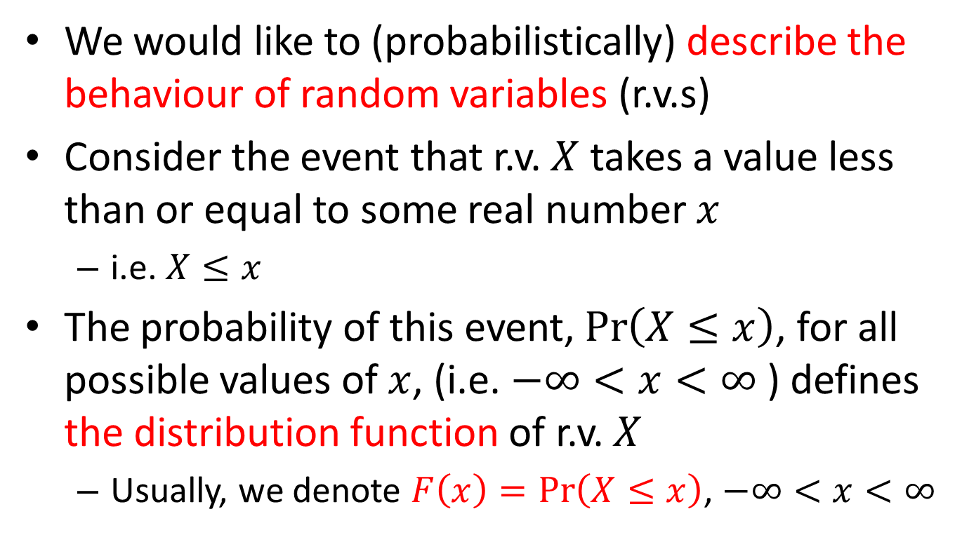
Introduction and Some Basics
We would like to (probabilistically) describe the behaviour of random variables (r.v.s)
Consider the event that r.v. $X$ takes a value less than or equal to some real number $x$
i.e. $X≤x$
The probability of this event, $\operatorname{Pr}\left(X≤x\right)$, for all possible values of $x$, (i.e. $−∞<x<∞$ ) defines the distribution function of r.v. $X$
Usually, we denote $F\left(x\right)=\operatorname{Pr}\left(X≤x\right)$, $−∞<x<∞$

Slide 15


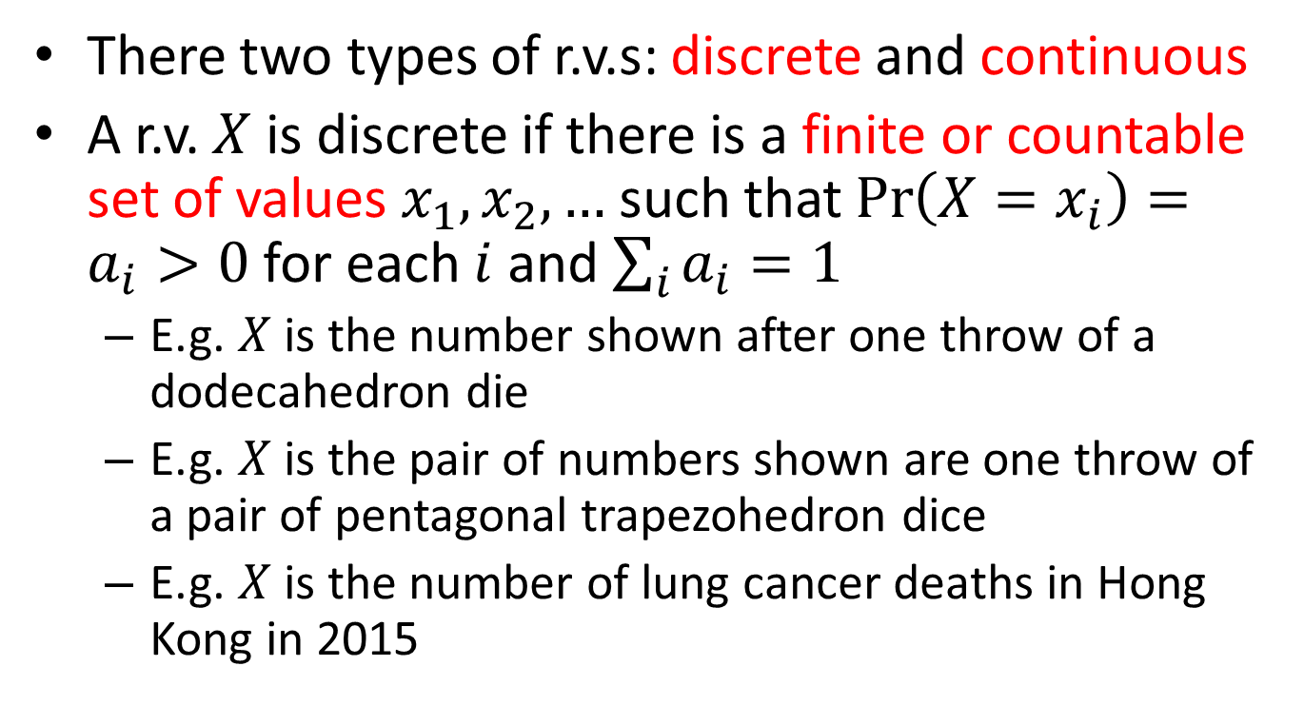
Introduction and Some Basics
There two types of r.v.s: discrete and continuous
A r.v. $X$ is discrete if there is a finite or countable set of values $x_{1}, x_{2},…$ such that $\operatorname{Pr}\left(X=x_{i}\right)=a_{i}>0$ for each $i$ and $\sum_{i}{a_{i}}=1$
E.g. $X$ is the number shown after one throw of a dodecahedron die
E.g. $X$ is the pair of numbers shown are one throw of a pair of pentagonal trapezohedron dice
E.g. $X$ is the number of lung cancer deaths in Hong Kong in 2015

Slide 16
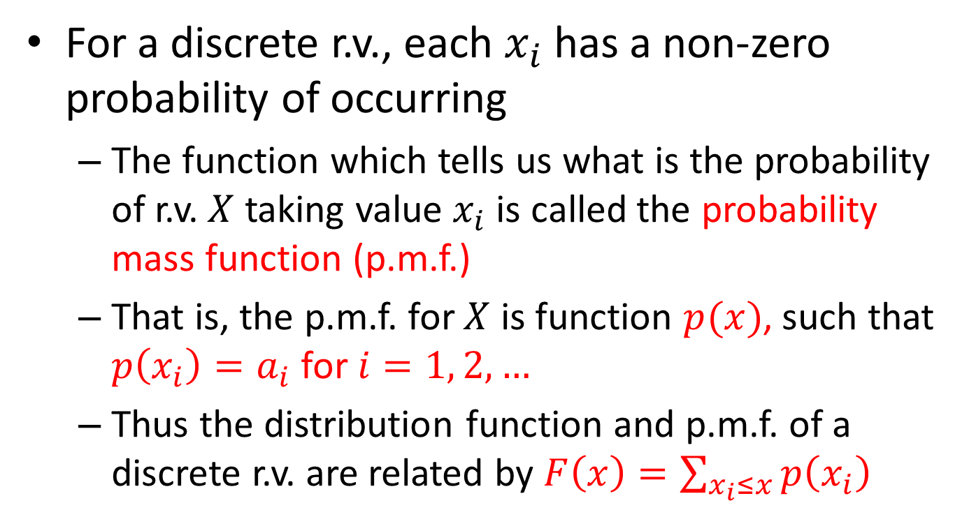
Introduction and Some Basics
For a discrete r.v., each $x_{i}$ has a non-zero probability of occurring
The function which tells us what is the probability of r.v. $X$ taking value $x_{i}$ is called the probability mass function (p.m.f.)
That is, the p.m.f. for $X$ is function $p(x)$, such that $p\left(x_{i}\right)=a_{i}$ for $i=1, 2,…$
Thus the distribution function and p.m.f. of a discrete r.v. are related by $F\left(x\right)=\sum_{x_{i}≤x}{p\left(x_{i}\right)}$

Slide 17
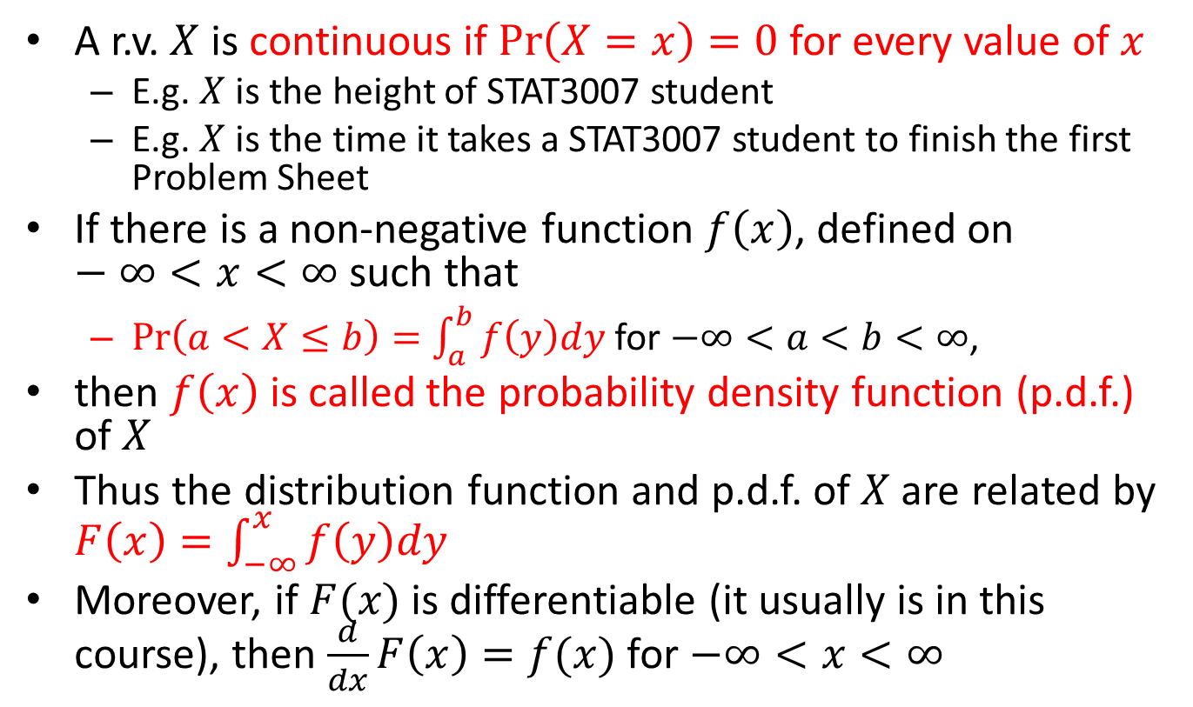
Introduction and Some Basics
A r.v. $X$ is continuous if $\operatorname{Pr}\left(X=x\right)=0$ for every value of $x$
E.g. $X$ is the height of STAT3007 student
E.g. $X$ is the time it takes a STAT3007 student to finish the first Problem Sheet
If there is a non-negative function $f\left(x\right)$, defined on $−∞<x<∞$ such that
$\operatorname{Pr}\left(a<X≤b\right)=\int_{a}^{b}{f\left(y\right)dy}$ for $−∞<a<b<∞$,
then $f\left(x\right)$ is called the probability density function (p.d.f.) of $X$
Thus the distribution function and p.d.f. of $X$ are related by $F\left(x\right)=\int_{−∞}^{x}{f\left(y\right)dy}$
Moreover, if $F(x)$ is differentiable (it usually is in this course), then $\frac{d}{dx}F\left(x\right)=f(x)$ for $−∞<x<∞$

Slide 18
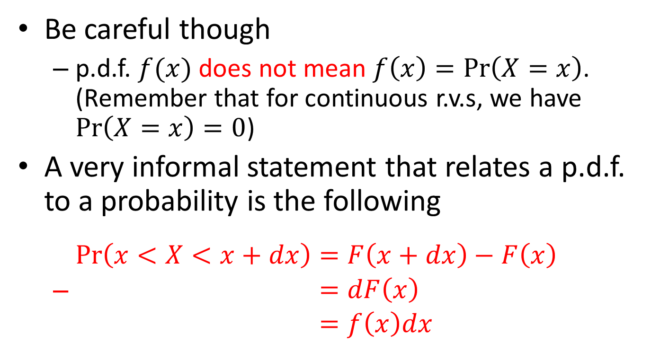
Introduction and Some Basics
Be careful though
p.d.f. $f(x)$ does not mean $f\left(x\right)=\operatorname{Pr}\left(X=x\right)$. (Remember that for continuous r.v.s, we have $\operatorname{Pr}\left(X=x\right)=0$)
A very informal statement that relates a p.d.f. to a probability is the following
$\begin{aligned}\operatorname{Pr}\left(x<X<x+dx\right)&=F\left(x+dx\right)−F\left(x\right) \\ &=dF\left(x\right) \\ &=f\left(x\right)dx\end{aligned}$

Slide 19
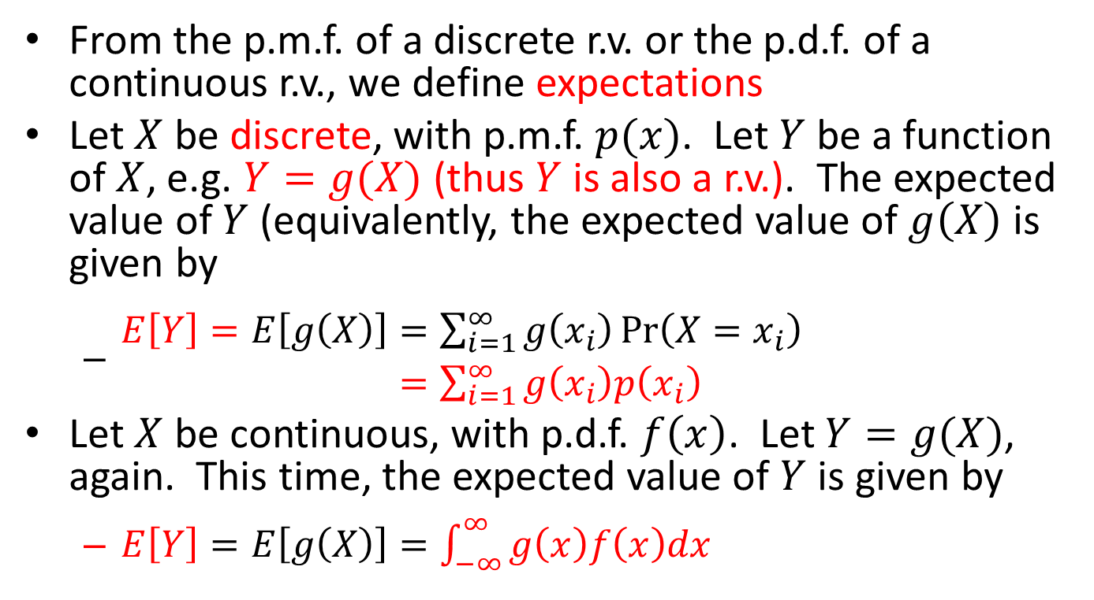
Introduction and Some Basics
From the p.m.f. of a discrete r.v. or the p.d.f. of a continuous r.v., we define expectations
Let $X$ be discrete, with p.m.f. $p(x)$. Let $Y$ be a function of $X$, e.g. $Y=g(X)$ (thus $Y$ is also a r.v.). The expected value of $Y$ (equivalently, the expected value of $g\left(X\right)$ is given by
$\begin{aligned}E\left[Y\right]=E\left[g\left(X\right)\right]&=\sum_{i=1}^{∞}{g\left(x_{i}\right)\operatorname{Pr}\left(X=x_{i}\right)} \\ &=\sum_{i=1}^{∞}{g\left(x_{i}\right)p\left(x_{i}\right)}\end{aligned}$
Let $X$ be continuous, with p.d.f. $f\left(x\right)$. Let $Y=g(X)$, again. This time, the expected value of $Y$ is given by
$E\left[Y\right]=E\left[g\left(X\right)\right]=\int_{−∞}^{∞}{g\left(x\right)f\left(x\right)dx}$

Slide 20
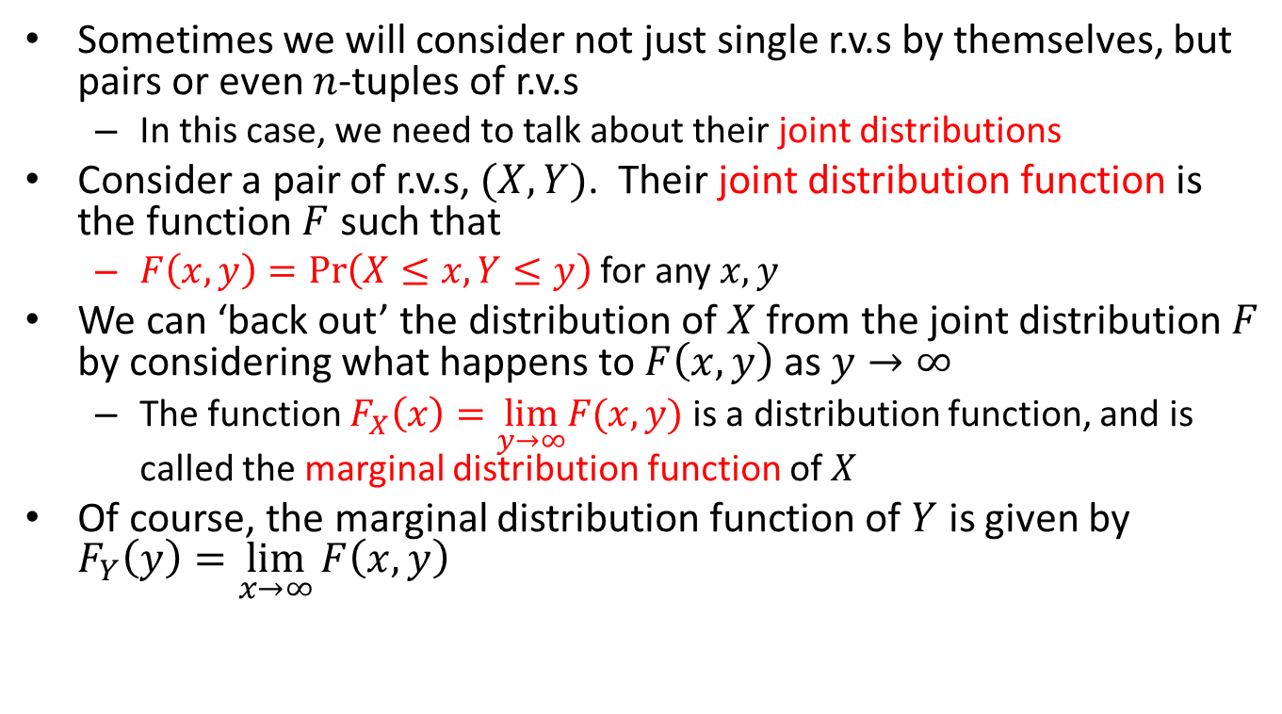
Introduction and Some Basics
Sometimes we will consider not just single r.v.s by themselves, but pairs or even $n$-tuples of r.v.s
In this case, we need to talk about their joint distributions
Consider a pair of r.v.s, $(X,Y)$. Their joint distribution function is the function $F$ such that
$F\left(x,y\right)=\operatorname{Pr}\left(X≤x,Y≤y\right)$ for any $x, y$
We can ‘back out’ the distribution of $X$ from the joint distribution $F$ by considering what happens to $F\left(x,y\right)$ as $y→∞$
The function $F_{X}\left(x\right)=\lim_{y→∞}F(x,y)$ is a distribution function, and is called the marginal distribution function of $X$
Of course, the marginal distribution function of $Y$ is given by $F_{Y}\left(y\right)=\lim_{x→∞}{F\left(x,y\right)}$

Slide 21
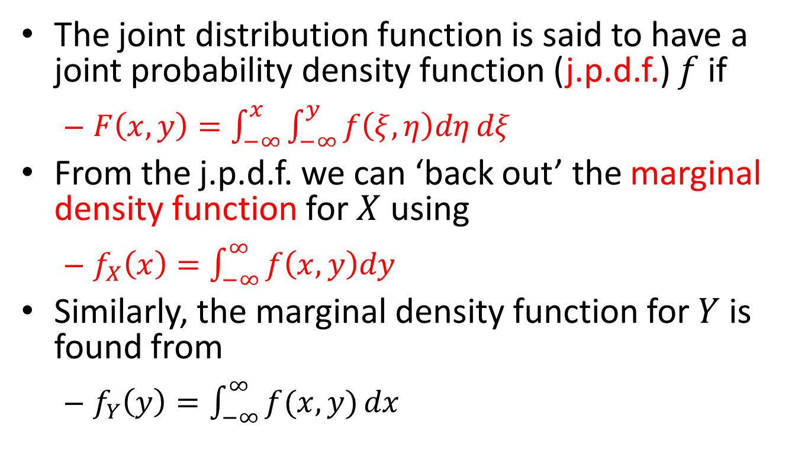
Introduction and Some Basics
The joint distribution function is said to have a joint probability density function (j.p.d.f.) $f$ if
$F\left(x,y\right)=\int_{−∞}^{x}{\int_{−∞}^{y}{f\left(ξ,η\right)dη}dξ}$
From the j.p.d.f. we can ‘back out’ the marginal density function for $X$ using
$f_{X}\left(x\right)=\int_{−∞}^{∞}{f\left(x,y\right)dy}$
Similarly, the marginal density function for $Y$ is found from
$f_{Y}\left(y\right)=\int_{−∞}^{∞}{f(x,y)}dx$

Slide 22
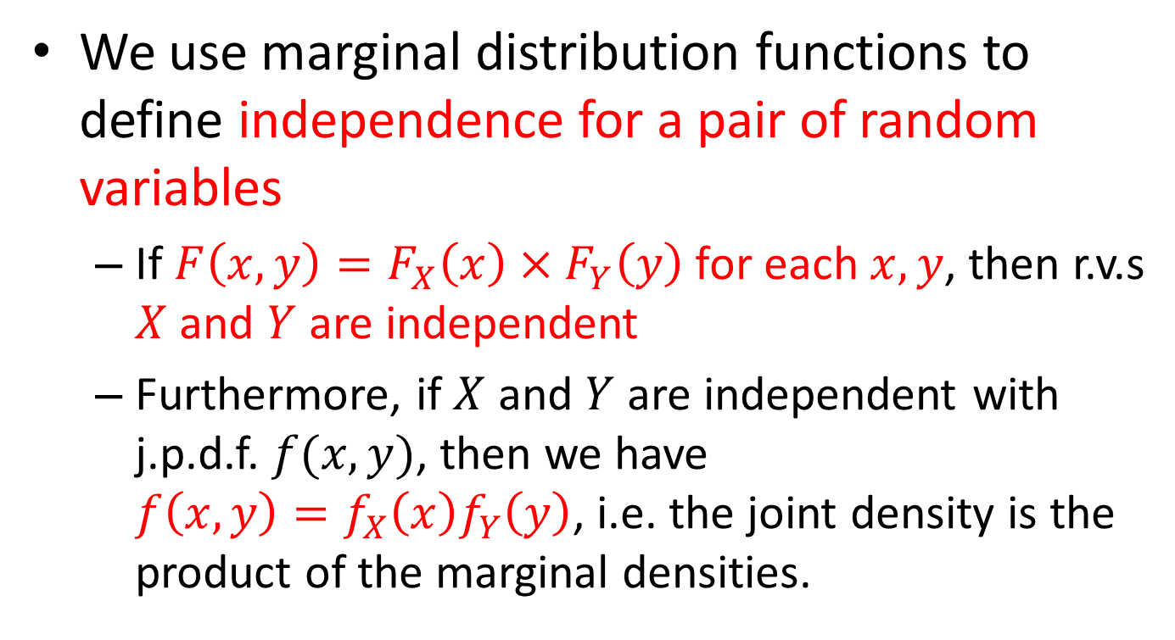
Introduction and Some Basics
We use marginal distribution functions to define independence for a pair of random variables
If $F\left(x,y\right)=F_{X}\left(x\right)×F_{Y}\left(y\right)$ for each $x, y$, then r.v.s $X$ and $Y$ are independent
Furthermore, if $X$ and $Y$ are independent with j.p.d.f. $f(x,y)$, then we have $f\left(x,y\right)=f_{X}\left(x\right)f_{Y}\left(y\right)$, i.e. the joint density is the product of the marginal densities.

Slide 23
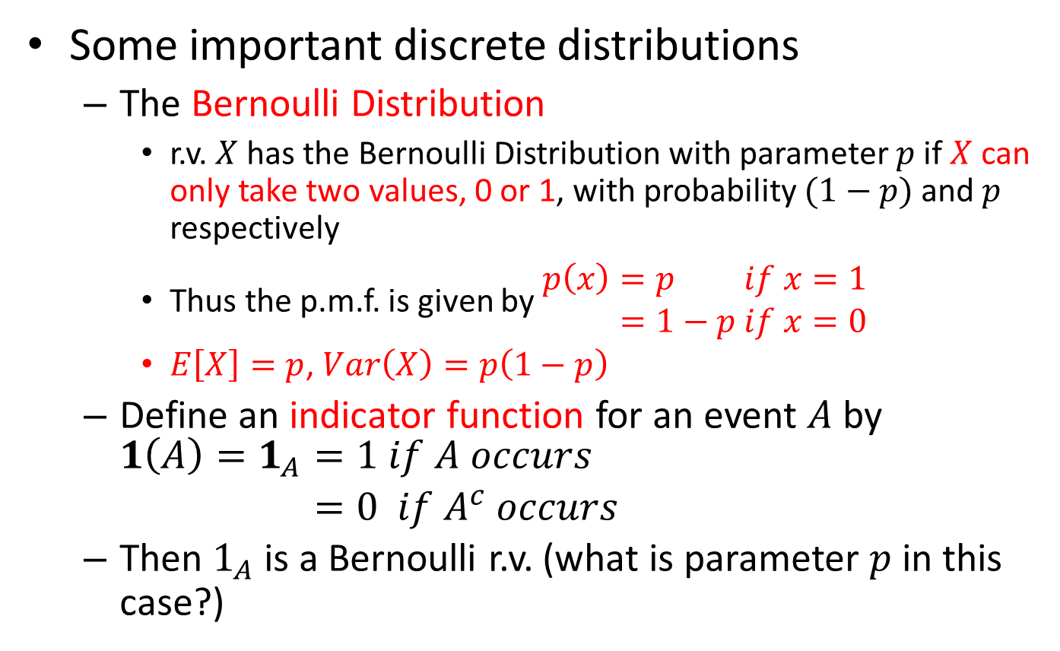
Introduction and Some Basics
Some important discrete distributions
The Bernoulli Distribution
r.v. $X$ has the Bernoulli Distribution with parameter $p$ if $X$ can only take two values, 0 or 1, with probability $(1−p)$ and $p$ respectively
Thus the p.m.f. is given by $\begin{aligned}p\left(x\right)&=p &if x=1 \\ &=1−p &if x=0\end{aligned}$
$E\left[X\right]=p$, $Var\left(X\right)=p\left(1−p\right)$
Define an indicator function for an event $A$ by $\begin{aligned}1\left(A\right)=1_{A}&=1 if A occurs \\ &=0 if A^{c} occurs\end{aligned}$
Then $1_{A}$ is a Bernoulli r.v. (what is parameter $p$ in this case?)

Slide 24
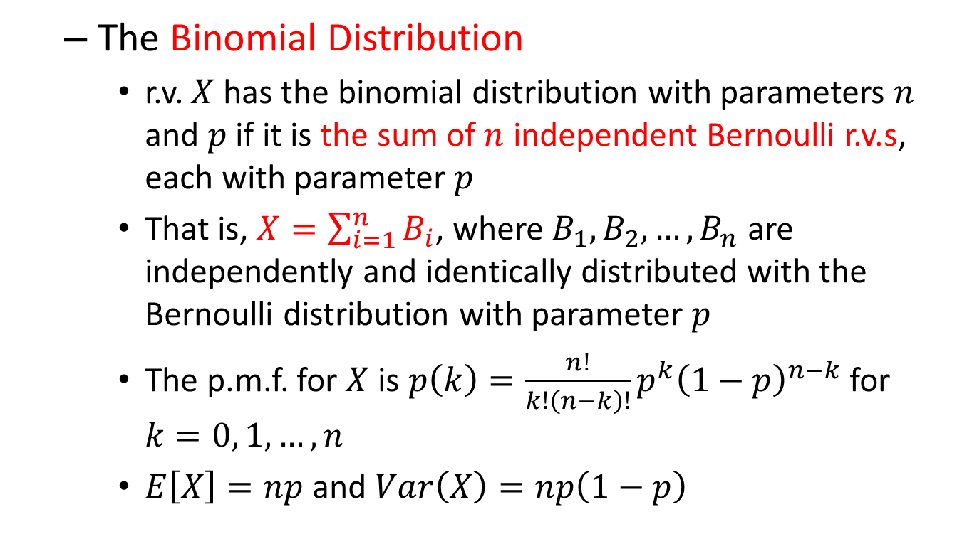
Introduction and Some Basics
The Binomial Distribution
r.v. $X$ has the binomial distribution with parameters $n$ and $p$ if it is the sum of $n$ independent Bernoulli r.v.s, each with parameter $p$
That is, $X=\sum_{i=1}^{n}{B_{i}}$, where $B_{1}, B_{2},…,B_{n}$ are independently and identically distributed with the Bernoulli distribution with parameter $p$
The p.m.f. for $X$ is $p\left(k\right)=\frac{n!}{k!\left(n−k\right)!}p^{k}{\left(1−p\right)}^{n−k}$ for $k=0, 1, …,n$
$E\left[X\right]=np$ and $Var\left(X\right)=np\left(1−p\right)$

Slide 25
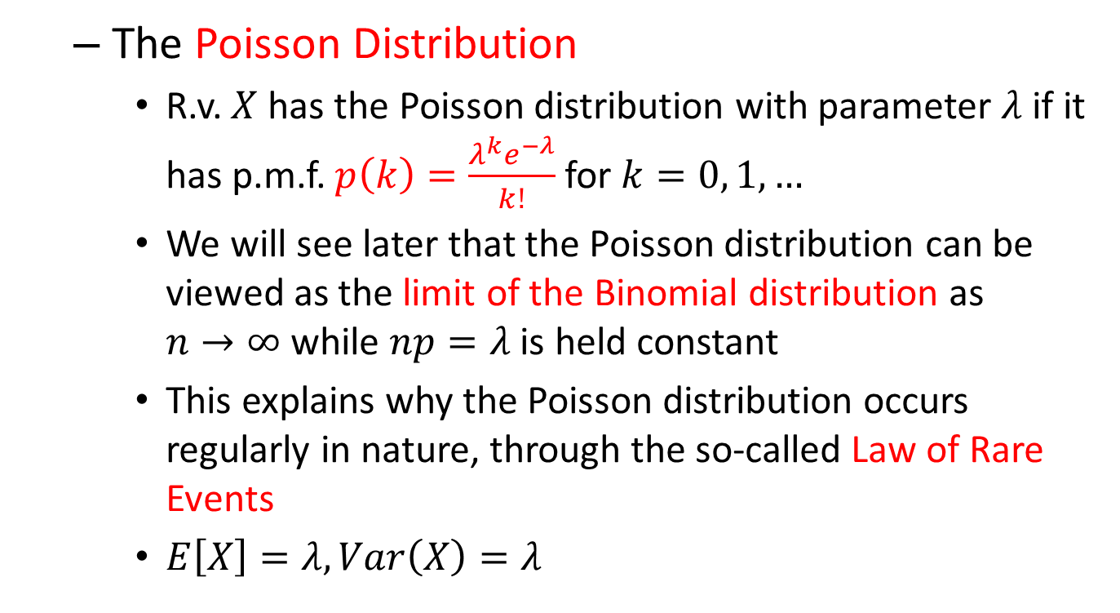
Introduction and Some Basics
The Poisson Distribution
R.v. $X$ has the Poisson distribution with parameter $λ$ if it has p.m.f. $p\left(k\right)=\frac{λ^{k}e^{−λ}}{k!}$ for $k=0, 1,…$
We will see later that the Poisson distribution can be viewed as the limit of the Binomial distribution as $n→∞$ while $np=λ$ is held constant
This explains why the Poisson distribution occurs regularly in nature, through the so-called Law of Rare Events
$E\left[X\right]=λ, Var\left(X\right)=λ$

Slide 26
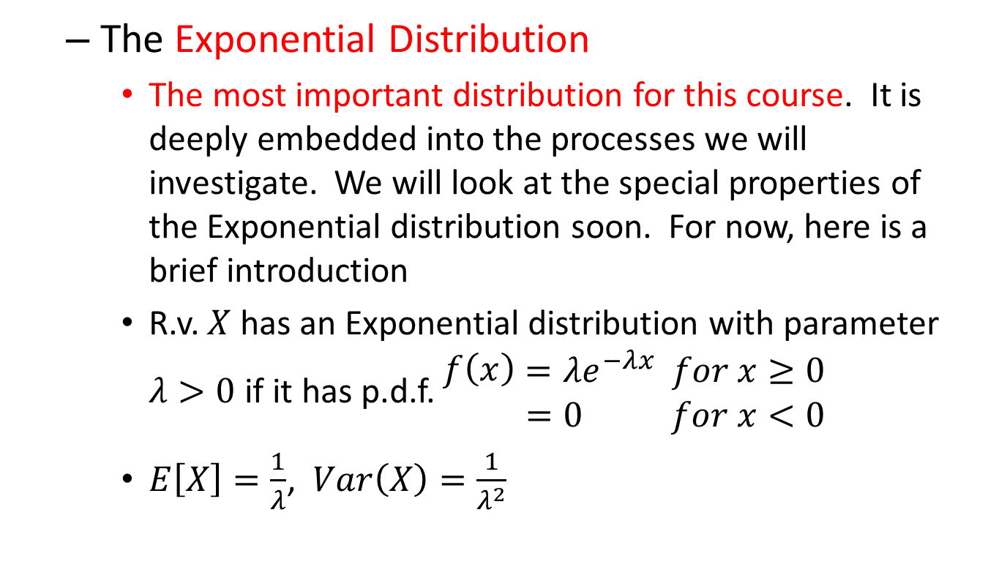
Introduction and Some Basics
The Exponential Distribution
The most important distribution for this course. It is deeply embedded into the processes we will investigate. We will look at the special properties of the Exponential distribution soon. For now, here is a brief introduction
R.v. $X$ has an Exponential distribution with parameter $λ>0$ if it has p.d.f. $\begin{aligned}\begin{aligned}f\left(x\right)\end{aligned}&=λe^{−λx} & for x≥0 \\ &=0 & for x<0\end{aligned}$
$E\left[X\right]=\frac{1}{λ}$, $Var\left(X\right)=\frac{1}{λ^{2}}$

